Slide 1
farewell
Izzy o’brien
From Hydration to Hygiene: Goodbye Pedialyte, Hello Listerine.
16 | February | 2023

Slide 2
There once was a gal named Izzy
A Pedialyte ABM oh so busy
She managed the powder, the budget too
And organic social content, through and through

Slide 3
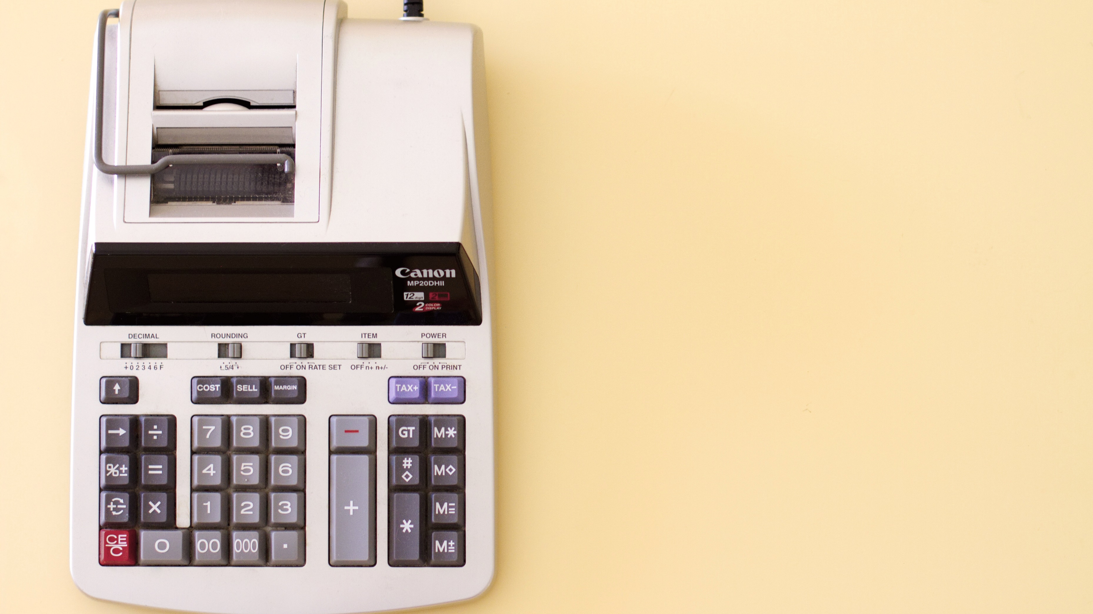
With her skills, the budget was always right
She managed powder supply and kept it tight
Izzy mastered powders in the consumption deck
And without her here, Tom might be a wreck

Slide 4
She’s lived across Arkansas, Florida, and North Carolina
But now she's moving, oh what a drama
To the land of the Sopranos and Jersey Shore
Where the turnpike tolls and the accents roar

Slide 5
But don't worry, dear Izzy, you'll fit right in
With your expertise in hydration, you're sure to win
You'll make the Garden State a healthier place
One electrolyte-infused smile on each face

Slide 6
Your Pedialyte team will miss you so
And Listerine's lucky, I bet they already know
Izzy is an excellent ABM, clever and smart
With her on board, the Listerine brand will be a work of art

Slide 7
She'll make sure all mouths stay fresh and clean
At Listerine, Izzy will become a true hygiene queen
From morning coffee to garlic and spice
You know Izzy will be giving great Listerine usage advice

Slide 8
So farewell, dear Izzy, we'll miss you so
But we know you'll shine, wherever you go
Listerine will be in great hands
Even though we all wish you were still here in our Ohio lands

Slide 9
Thank you

